Slide 1
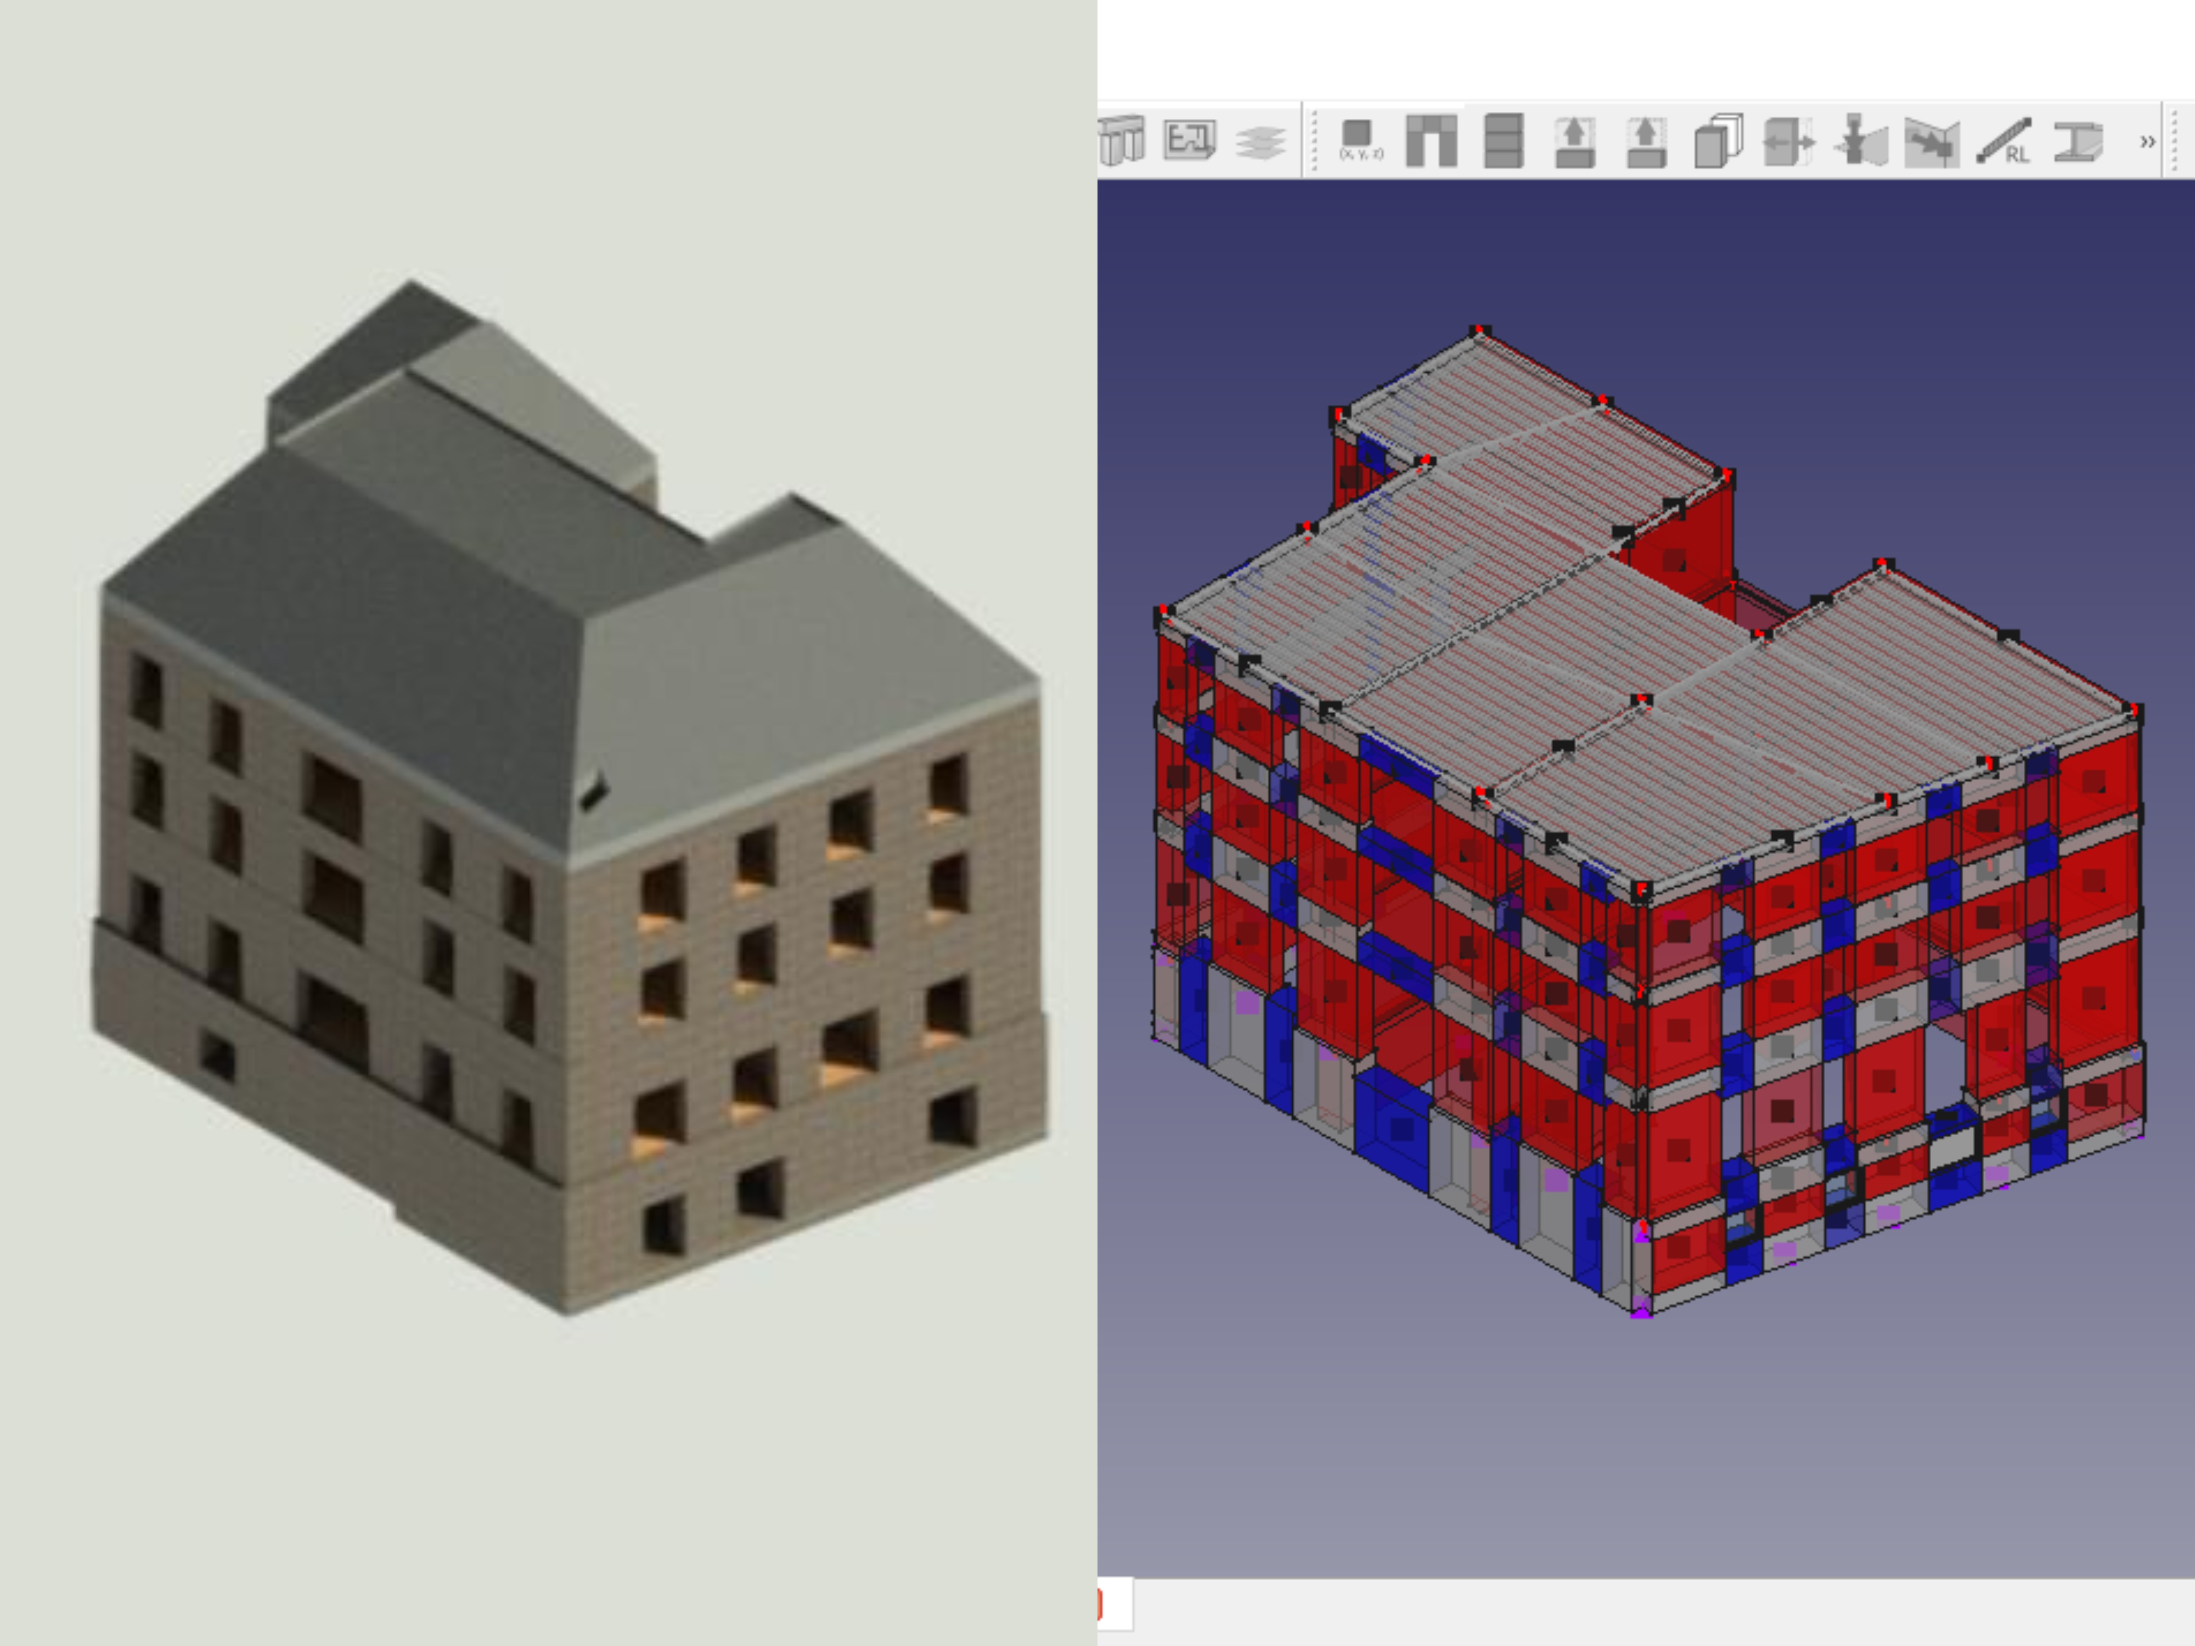
Definition and implementation of a BIM integrated fully reproducible workflow for the computation of vulnerability functions of URM buildings
Midterm presentation
https://epfl.zoom.us/j/4152740646

Slide 2
Content
1. Literature review summary
2. Case study presentation
3. BIM modeling
4. Transfer to FE application and interoperability
5. Capacity determination using EFM through SAMUEL
6. Peak demand and OSR verification
7. Building models database
8. Next steps

Slide 3
1. Literature review
BIM modeling of URM buildings
URM buildings context
BIM, important notions
Modeling URM in BIM
BIM databases of buildings as input for FE models
Data management in BIM
Interoperability between BIM and FE applications
The concept of BIM database
Equivalent frame models (EFM) of URM buildings
Seismic behavior of URM buildings
Description of the EFM method

Slide 4
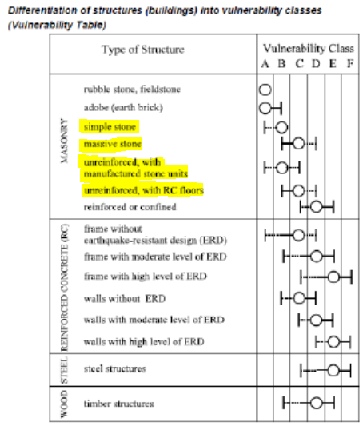
URM buildings context
@ European Macro-seismic scale, 1998
Important part of the ageing (historical) building stock
Most vulnerable to earthquake in comparison with other types of structures
Correct earthquake resistance assessment is important from an economical and socio-cultural point of view
URM behavior is highly dependent on the building masonry and floors typology

Slide 5
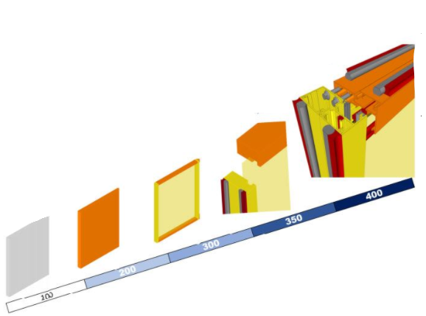
Important BIM notions
Building Information Modeling: geometry + property data
Level of detail (LOD)
100: Symbolic representation
200: Generic, approximate placeholder
300: Specific (quantity, geometry etc.)
350: Specific + supports and connections
400: Sufficient details for fabrication
500: Field verified representation
OpenBIM: File exchange and file conversion are supported (by opposition with ClosedBIM)
@BIMforum

Slide 6
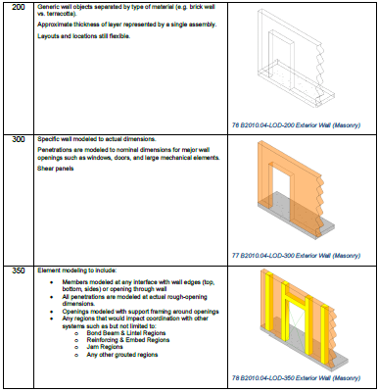
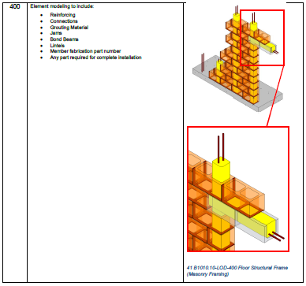
Modeling URM in BIM
Most software fully support masonry modeling only until LOD 300
Work arounds are generally needed for modeling connections
@BIMforum

Slide 7
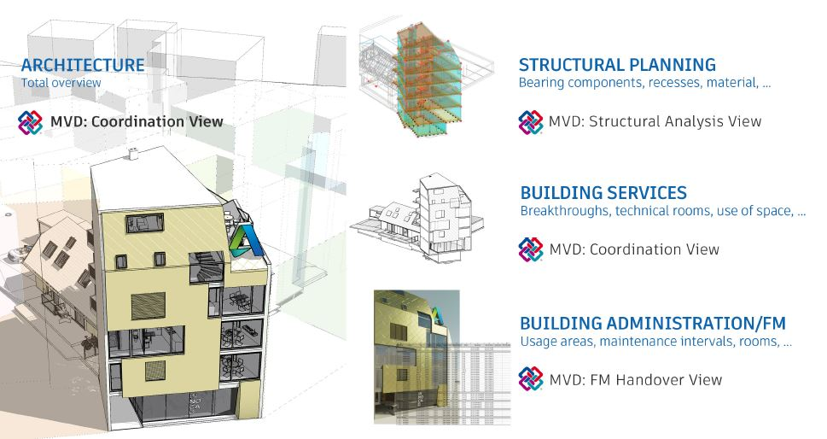
Data management in BIM
Exchange format: Industry foundation classes (IFC)
ISO 16739:2013 standardized
Exchange of 3D geometry and property
data (not intended for 2D views)
Different versions (IFC 4, IFC 2x3 etc.)
Model view definition (MVD)
Based on the use
Structural application
Design transfer view
Analytical model is key
@Autodesk

Slide 8
Transfer to FE application and interoperability
Transfer of IFC file described precedingly
Level of interoperability highly depends on software
FreeCAD ( Opensource parametric modeler used by SAMUEL)
Level of interoperability does not permit FE applications yet (IfcOpenShell unfunctional)
BuildingSMART certification (by IFC version)
Ensures a good level of interoperability

Slide 9
BIM database concept
CAD models database: Mechanical engineering roots (since 1984)
aero-spatial, automotive industry, 3D printing technology etc.
e.g. grabcad.com (community driven sharing platform)
Finite element models database for structures design automation
Idea originated for offshore marine structures
Nader Shebini 1989 patent in USA for McDermott Engineering
Coupling the idea with BIM
Powerful given the widespread and increasing usage by AEC industry
First step for full automation of structural design (AI, machine learning…)
AI based generative design of structures implementation has already begun
e.g. Autodesk Revit Generative design

Slide 10
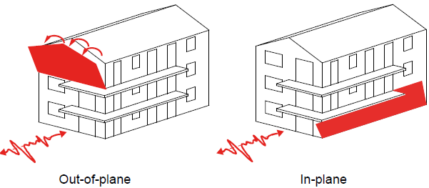
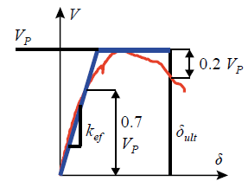
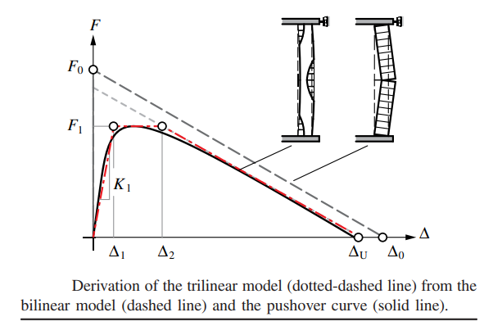
Seismic behavior of URM buildings
2 principal failure mechanisms
In-plane
Out of plane (OOP)
Elastic-plastic behavior
In-plane OOP
@ Civil 522 EPFL

Slide 11
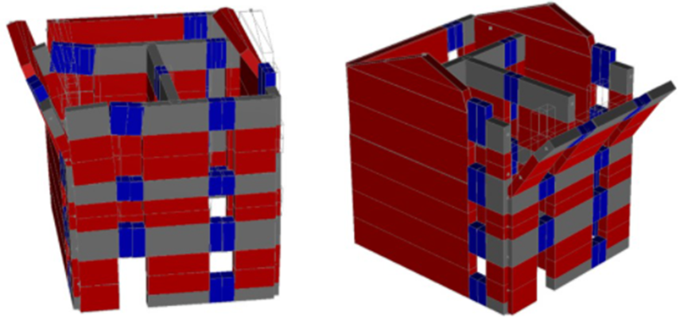
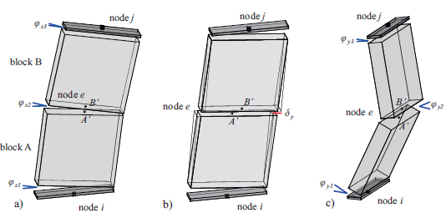
EFM analysis
Decomposition of an URM building’s walls into piers (in red) and spandrels (in blue), connected by rigid nodes (in grey), thus making sets of equivalent frames
Masonry piers behaves like precedingly described (elastic-plastic in-plane and OOP)
Masonry spandrels behave like beams
@github.com/eesd-epfl/OpenSees/wiki

Slide 12
2. Case study presentation
Typology
3D views
2D geometric survey plans

Slide 13
Typology
General characteristics:
Address: Basel Switzerland
Office building: commercial and administration usage
Year of construction: 1901
Number of storeys: 3 without counting basement and attic
Construction volume: 7098 m³
Floor boundary area: 340 m²
Assured value: 8 mio CHF
Structural characteristics:
Massive stone masonry shell (exterior and some interior walls)
Timber wood floor slabs
Pitched timber roof
Even more massive stone masonry wall foundations

Slide 14
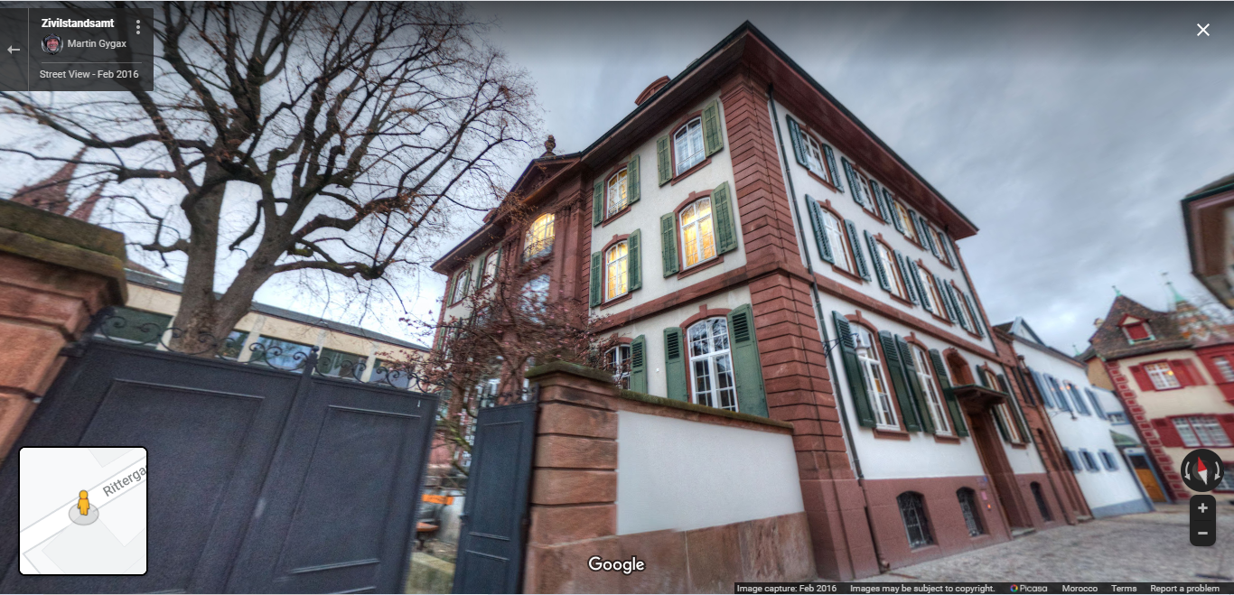
3D view: Google streetview

Slide 15
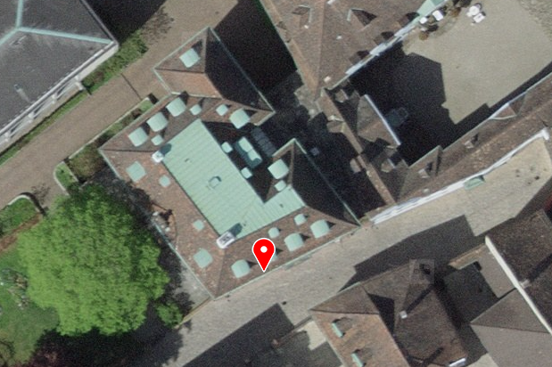
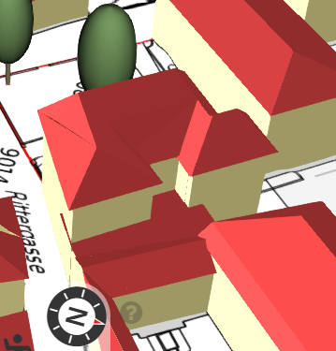
3D views: Swisstopo (Aerial and buildings3D)

Slide 16
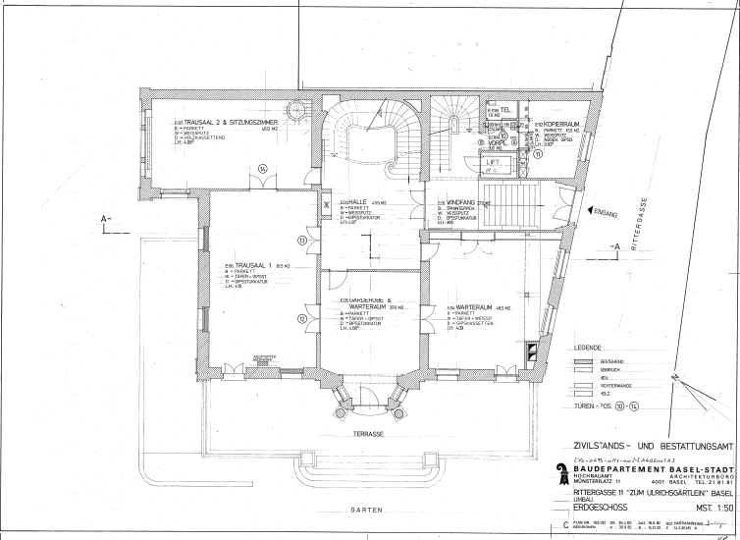
2D survey: Ground floor

Slide 17
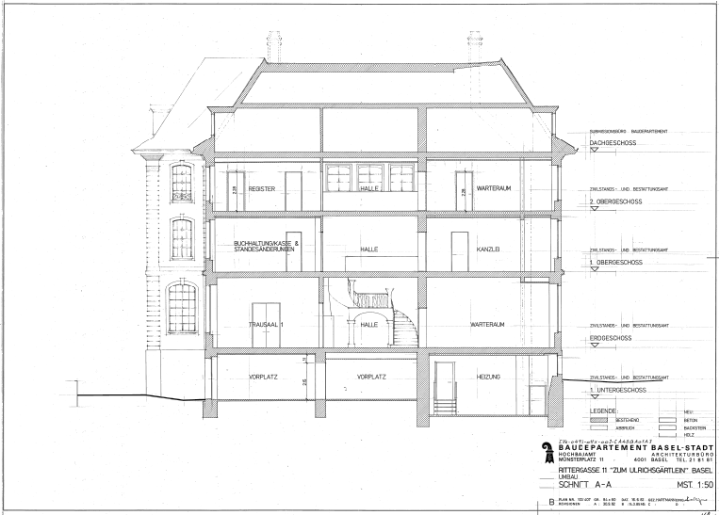
2D survey: Cut

Slide 18
3. BIM modeling
LOD 200
LOD 300
Using Revit
GUI based workflows shared

Slide 19
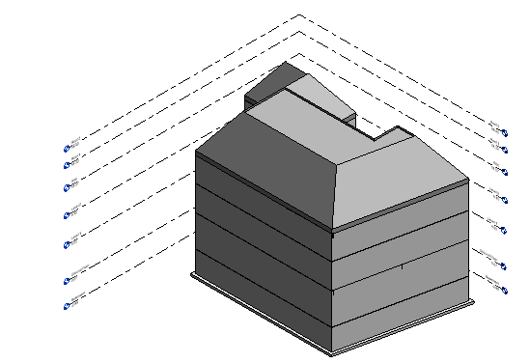
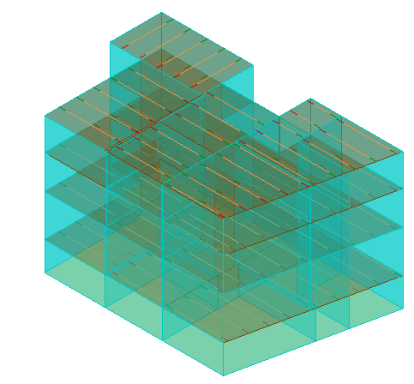
LOD 200, 3D
3D physical
3D analytical

Slide 20
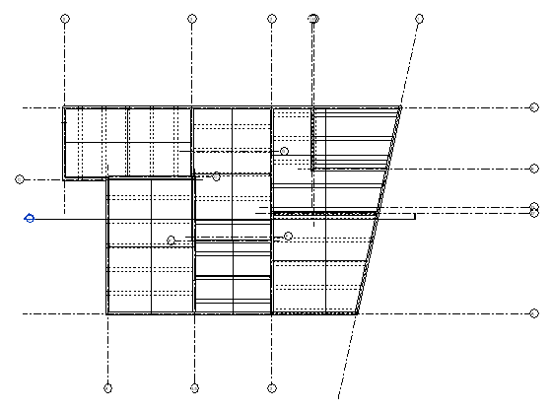
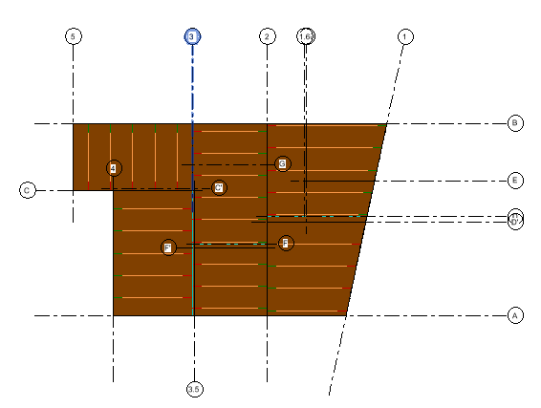
LOD 200, 2D Ground floor
2D Physical
2D Analytical

Slide 21
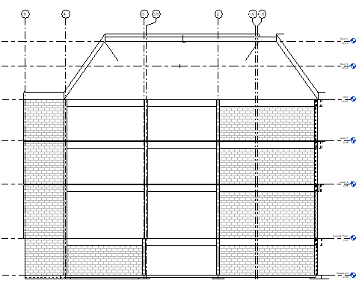

LOD 200, Cut
Cut Physical
Cut Analytical

Slide 22
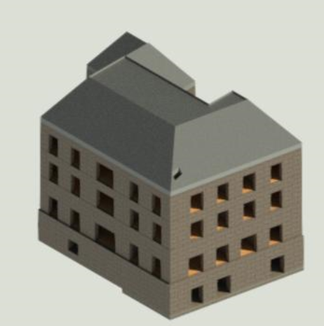
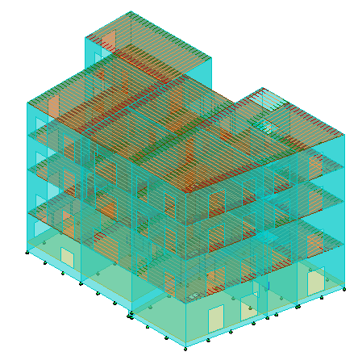
LOD 300, 3D
3D physical
3D analytical

Slide 23
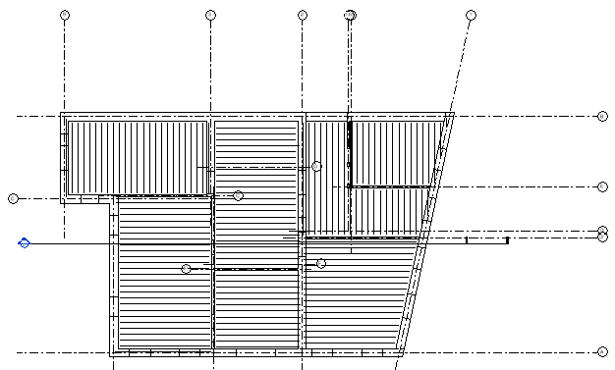
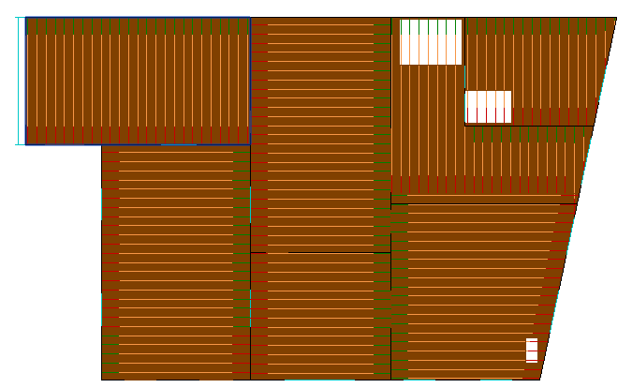
LOD 300, 2D Ground floor
2D Physical
2D Analytical

Slide 24
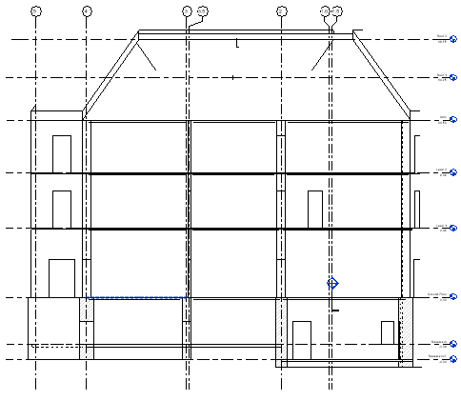
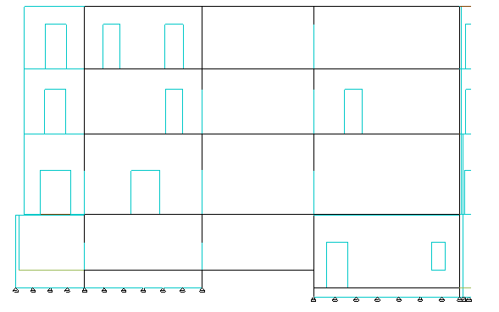
LOD 300, Cut
Cut Physical
Cut Analytical

Slide 25
4. Transfer to FE application and interoperability
Transfer from BIM to SAMUEL for EFM application is not possible yet
Interoperability issue has to do with FreeCAD 0.19 IFC processing tool, IfcOpenShell which only permit vizualisation
Workaround solution: Use the FreeCAD generated model by T.A. Ivana Bozulic

Slide 26
5. Capacity determination using SAMUEL
Structural model
Pushover analysis
Analysis results
Conditions

Slide 27
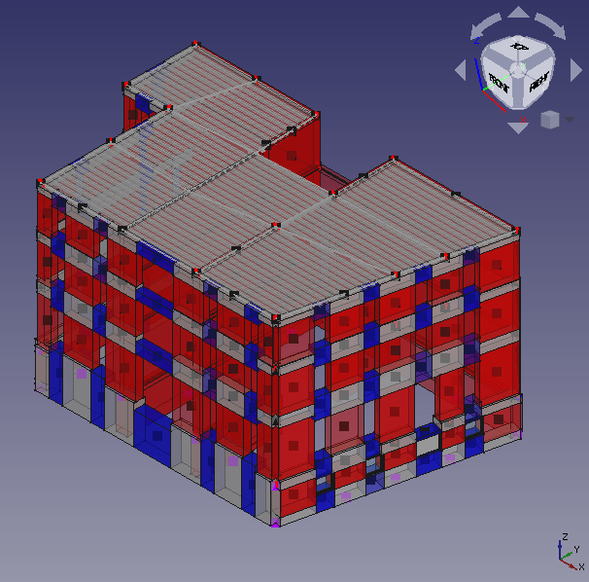
Structural model
Spatial structural model
containing principal structural
members
Principal walls (with openings)
Floors diaphragms
Semi-automated EFM mesh
generation through SAMUEL’s
Python opensource code

Slide 28
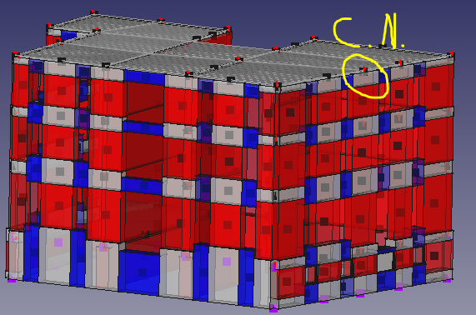
Pushover analysis
Displacements imposed on the control node
Iterative procedure to solve differential
equations based on the theory presented at
the literature review
Considers self-weight through simultaneous analysis
Result is a force-displacement relationship of
the structure
Visualization of the global behavior is also possible

Slide 29
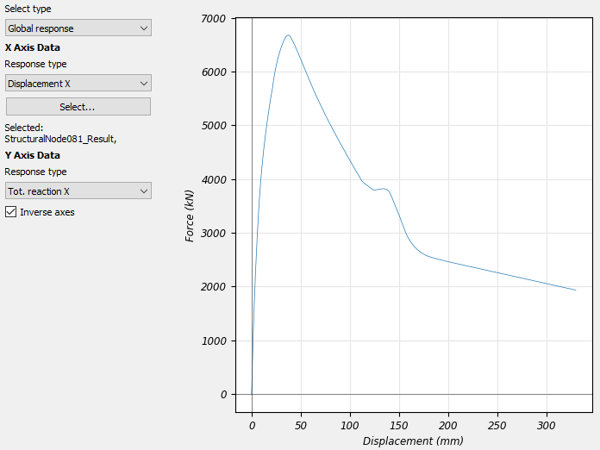
Analysis results
V_peak
V_ult = 80% V_peak
Analysis type
Pushover, rect
Note: All values are absolute
 | Displacements |  | Forces
Units | mm |  | kN
Direction, sense | V_peak | d_peak | 80% V_peak | d_ult
X, positive | 6311.46 | 45.12 | 5049.17 | 81.20
X, negative | 6678.45 | 37.70 | 5342.76 | 78.70
Y, positive | 6148.03 | 44.03 | 4918.42 | 371.73
Y, negative | 7105.13 | 53.15 | 5684.11 | 136.77
d_ult
d_peak
In plane behavior (C.N.)
Eurocode 8-3: Confidence factor (See conditions next)
CF(KL1) = 1.35
C_d= d_ult/CF
C_d = 58 mm
Ultimate deformation capacity design value

Slide 30
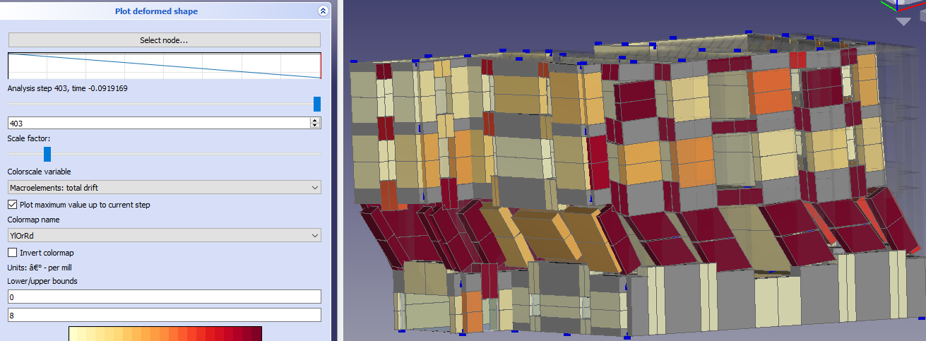
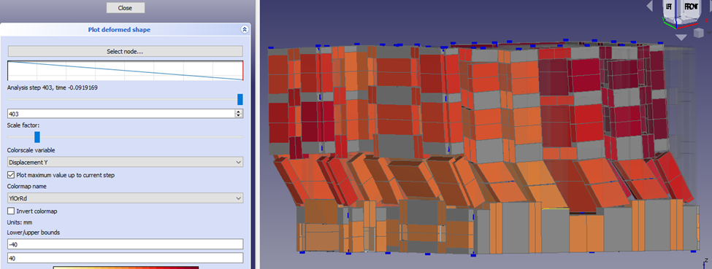
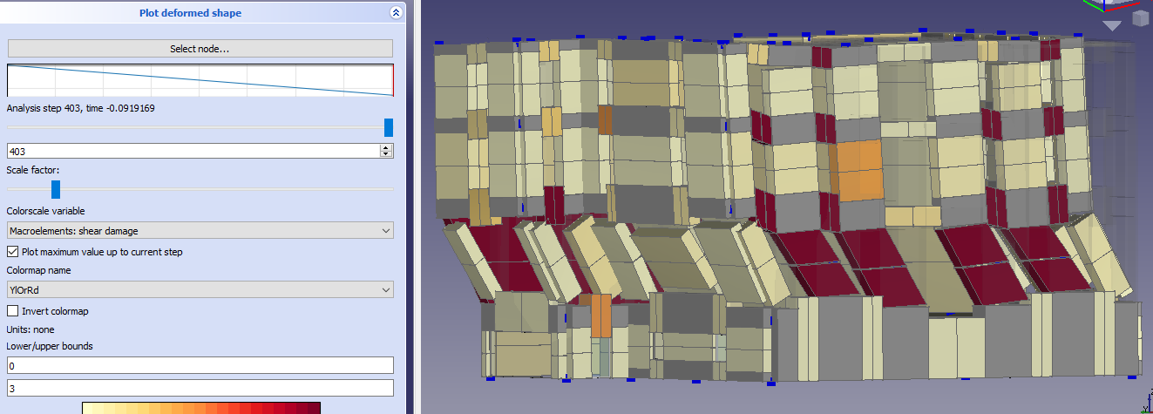
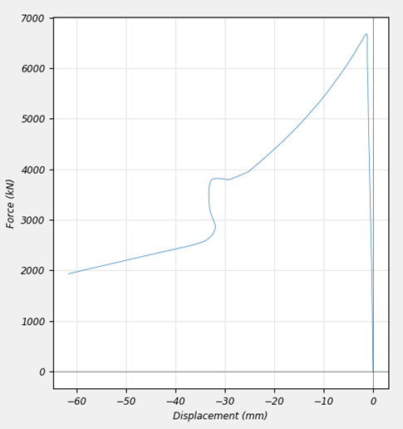
Global behavior visualization
Total drift
OOP displacement
High concentration of drifts and shear damage at the ground floor
Measures should be taken to assure sufficient ductility at this level for the analysis to make sense (see conditions next)
Soft-storey mechanism must be avoided !
Shear damage
OOP behavior (C.N.)

Slide 31
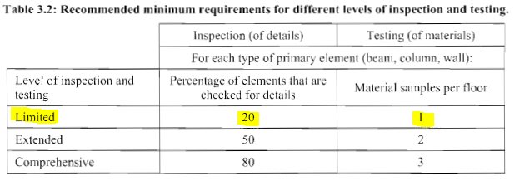
Conditions
@ Eurocode 8 part 3
Knowledge level
Geometry
Survey of structural &
nonstructural elements
Material
NDT & DT
Detailing
(EC8 does not recommend pushover at KL1)
Details to be checked – particularly around ground floor (non exhaustive):
Mortar joints quality and condition
Type and condition of orthogonal walls connections
Type and condition of floor-to-wall connections
Second analysis recommended - e.g. triangular distribution of forces
deformation capacity tends to be similar for short buildings, @Akbas 2003

Slide 32
6. Peak demand and OSR verification
Elastic response spectrum
Soil categorization
Other parameters
Design response spectrum
Fundamental period and peak demand
Overstrength ratio
Assessment and recommendations

Slide 33
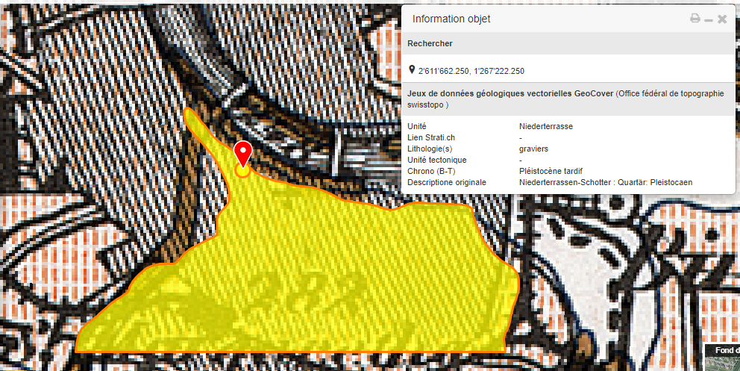
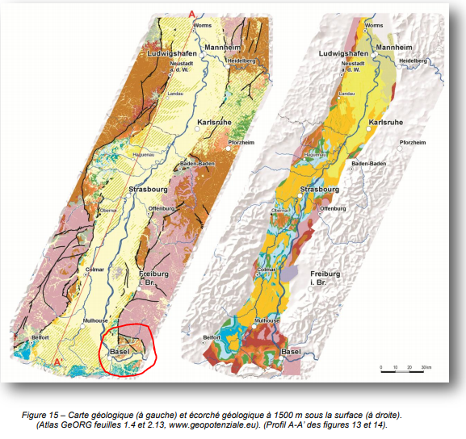
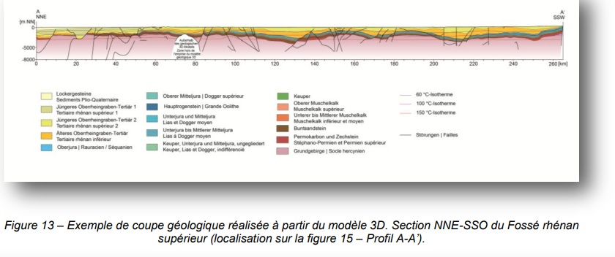
Soil categorization
Online documentation
https://map.geo.admin.ch/
Gravel alluvium
https://www.geopotenziale.org/
Shallow Plio-Quaternary
unconsolidated alluvium layer over
a deep Tertiary layer of indurated
marl or sandstone
Soil is probably class A (or E depending
on the alluvium layer width – >5m)
Further geotechnical investigation should be performed to confirm

Slide 34
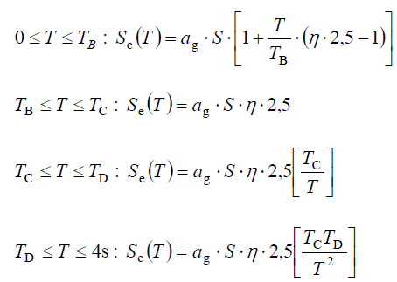
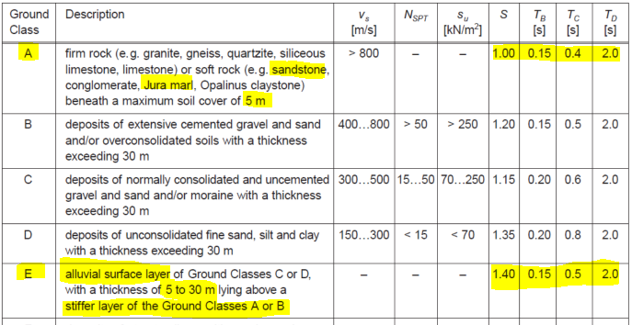
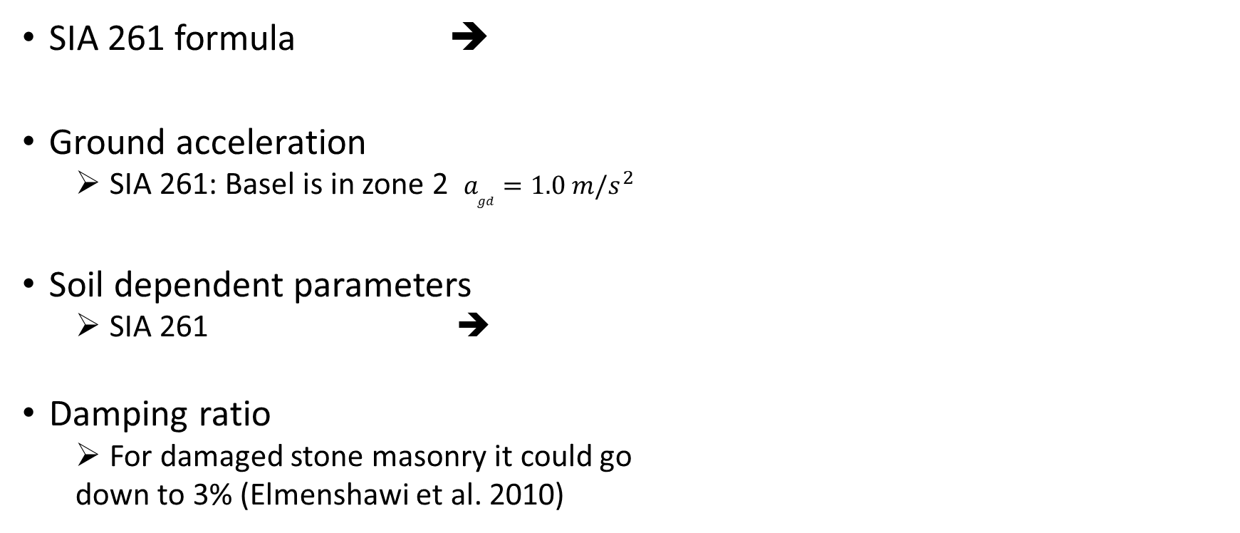
Elastic response spectrum calculation
SIA 261 formula ➔
Ground acceleration
SIA 261: Basel is in zone 2 $a_{gd}=1.0 m/s^{2}$
Soil dependent parameters
SIA 261 ➔
Damping ratio
For damaged stone masonry it could go
down to 3% (Elmenshawi et al. 2010)

Slide 35
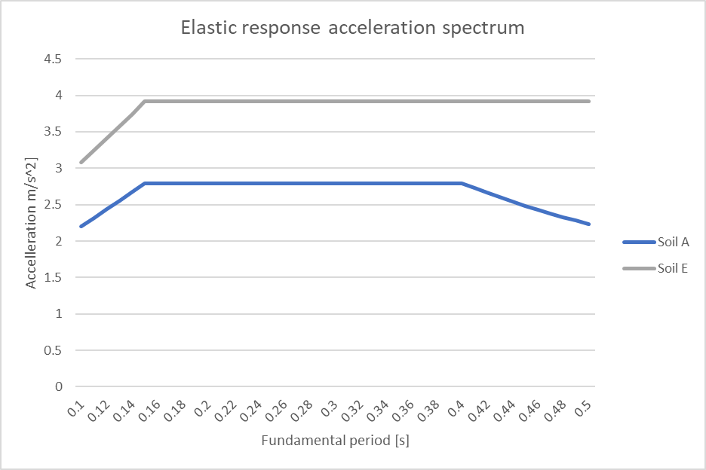
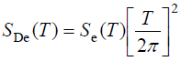
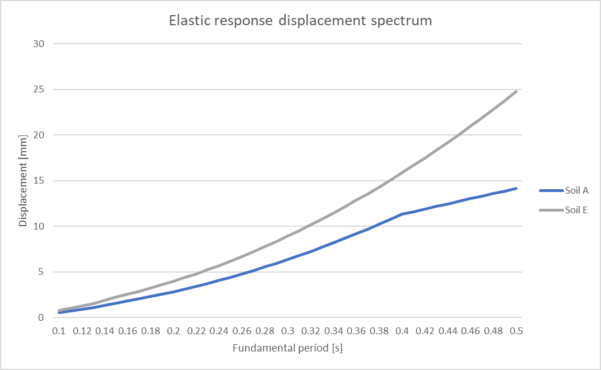
Elastic response spectrums result
Acceleration
Displacement

Slide 36
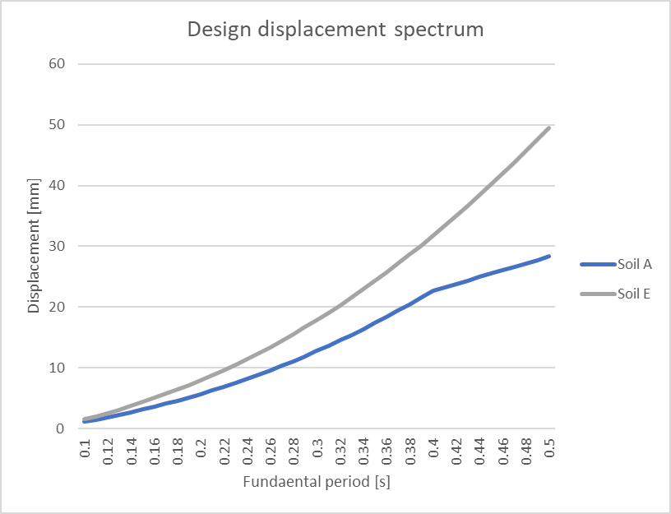
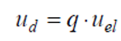
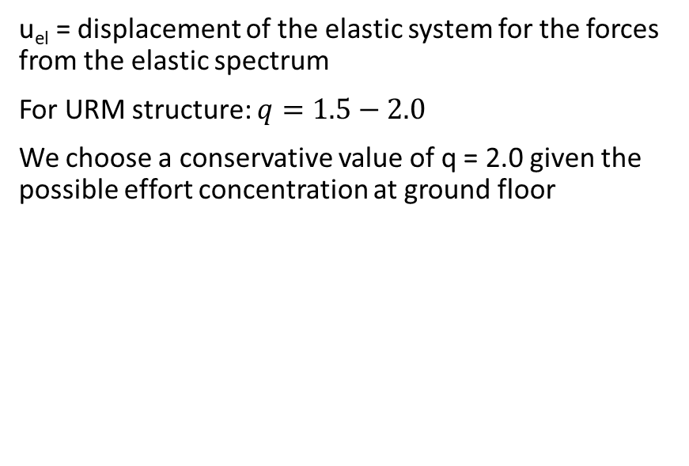
Design spectrum
u_{el} = displacement of the elastic system for the forces from the elastic spectrum
For URM structure: $q=1.5−2.0$
We choose a conservative value of q = 2.0 given the possible effort concentration at ground floor

Slide 37
Fundamental period and peak demand
Method | T₁
Empirical 1 (storeys) | 0.3 s
Empirical 2 (height) | 0.31 s
Rayleigh simplified | ?
Similar stone buildings [1] | 0.17-0.43 s
Numerical, SAMUEL | 0.305 s
[1] A. Elmenshawi et al. 2010
Limit state | E_d Soil A [mm] | E_d Soil E [mm]
No Collapse | 13.61 | 19.05
Significant damage | 13.61 | 19.05
Damage limitation (elastic spectrum) | 6.80 | 9.53

Slide 38
Over Strength Ratio
Limit state and capacity
No Collapse
Ultimate design capacity C_d
Significant Damage
¾ C_d
Damage Limitation
Design peak elastic displacement
d_peak/CF
Limit state | C_d [mm] | OSR Soil A | OSR Soil E
No Collapse | 58.00 | 4.26 | 3.04
Significant Damage | 43.50 | 3.20 | 2.28
Damage Limitation | 27.41 | 4.03 | 2.88

Slide 39
Assessment and recommendations
OSR stays way above the 1.0 limit
Remember conditions to be checked for capacity design
e.g. detailing, material, in-situ loads distribution etc.
If conditions are not met
Repair and strengthening –specially ground floor (e.g. following Eurocode 8-3 Annex C5)
Sealing/Grouting of eventual small cracks
Cross bonded stones at wall intersections (e.g. RC belts, Steel plates/Meshes)
Strengthening and stiffening of the timber floors
e.g. double diagonal steel-ties mesh anchored to the perimeter walls
Anchoring and bracing of roof trusses to the supporting walls. Horizontal bracing should be added to the bottom chords if nonexistent
Strengthen the overall behavior by adding steel ties (or tie beams) between walls
Adjacent unit effect should be analyzed

Slide 40
7. Building models database
Context
Relational database (user POV)
With interoperability
No interoperability
Stockage of digital data
Local machine
Local server
Cloud-based

Slide 41
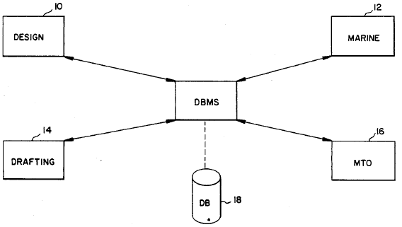
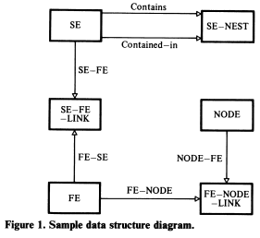
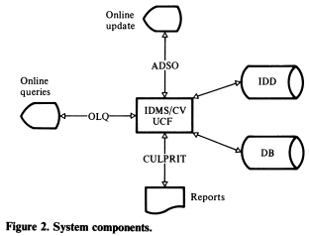
Building models database context
@Shebini, 1985
EESD lab
Spatial building models to numerically study earthquake behavior
Advances in BIM technology
Opportunity
Current obstacle
Interoperability (IfcOpenShell)

Slide 42


Relational database (user POV)
Interoperability
No interoperability

Slide 43
Stockage of digital data
Local machine
Bad for teamwork (e-mail exchanges not optimal)
Bad for conservation and changes traceability
Local server
Most used in AEC industry (organization network)
Cloud-based open solutions
Opensource solutions like github
Development idea: Community driven website like grabcad.com

Slide 44
8. Next steps
Simplified force-based checks (excel worksheets)
Magnitude order check
Comparison with other numerical solutions
Easy since BIM model already exists
Dynamic analysis
To get vulnerability functions
Damping & inertial effects (e.g. force distribution) intrinsically considered
Analyze adjacent unit effect on model results
Accidental eccentricities effect
Make the workflow fully reproducible
Through python code posted on Renku

Slide 45
Thanks
Professor Katrin Beyer for the project opportunity
T.A. Ivana Bozulic for her precious help

Slide 46

Quick ULS (linear) mechanism check(FE-Robot)
Not same model (Same wall elastic properties + secondary walls + C20 joists)
Same direction
Same sense
Similar ULS displacement (87 mm, CQC)

